Slide 1
creating community taxonomies

Slide 2
introduction
CREATING A SUCCESSFUL TAXONOMY
CREATING A SUCCESSFUL TAXONOMY
Creating a good taxonomy is (very slightly) like working at the CIA. If you do your job well, nobody will notice. But if you make a mistake you will critical undermine your community.
Taxonomies are a ‘boring’ topic in community circles but one which is critical to the success of a community. Great taxonomies provide a simple, intuitive, means for members to navigate through a community, find what they want, and engage how they like.
If the taxonomy is poorly structured or if if isn’t intuitive to members, you will be plagued by members forever struggling to find the content they need and lower participation rates.
Taxonomies can range significantly in complexity. The simplest taxonomy would be a simple, flat, taxonomy in which every item is linked to from the homepage. This obviously isn’t practical in a community given the amount of content. Thus most will use a hierarchical taxonomy with content available as members drill down into each area.
You may also consider using a network taxonomy in which there is a hierarchical structure of content with some content being linked by associations to other content.
Finally there is a facet taxonomy in which many types of content are associated with many other types of content and can be visited as such.
The taxonomy you design should reflect the use cases, priorities, and trade-offs you’ve made throughout the reach process.

Slide 3
creating a successful taxonomy
CREATING A SUCCESSFUL TAXONOMY
How do you guide the member experience?
The most critical decision you make early on is which prism will you use to guide the entire member experience. Most communities pick at least one of the following four options:
User type (customer ,develop, partner, reseller).
Product (product 1, product 2, product 3 etc..)
Sector (retail, business to business, business to consumer).
Visiting intent (collaborate, share, get help).
key decisions

Slide 4
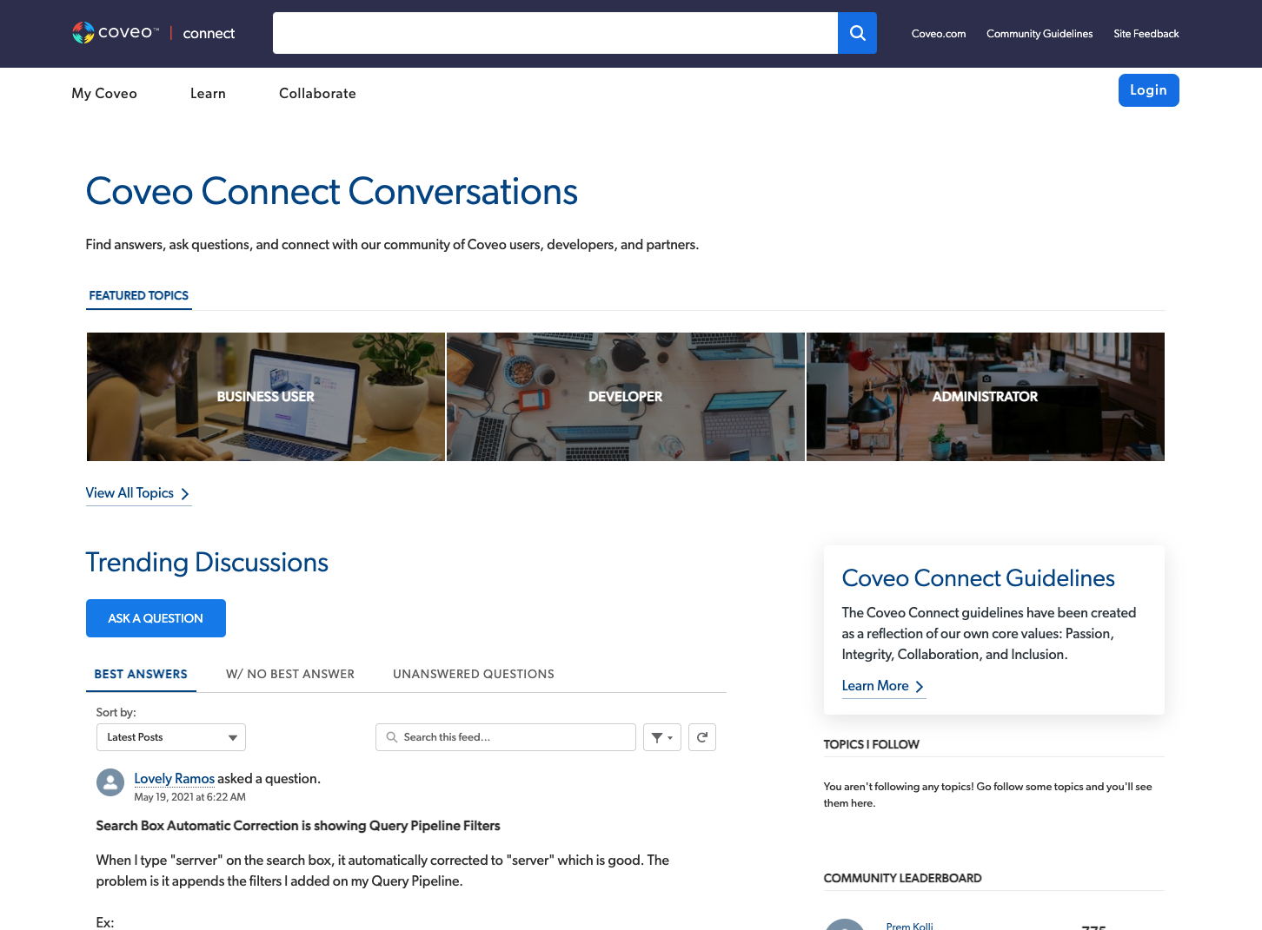
categorisation types
CREATING A SUCCESSFUL TAXONOMY
BY TYPE OF VISITOR
While there is some ‘intent’ categorisation in the top navigation bar, the primary type of categorisation in this community is by the type of visitor (business, developer, or administrator). This works well when you have audiences with clearly different needs. However this often means the homepage is simply a spring broad to areas of the community with more specific types of categorisation

Slide 5
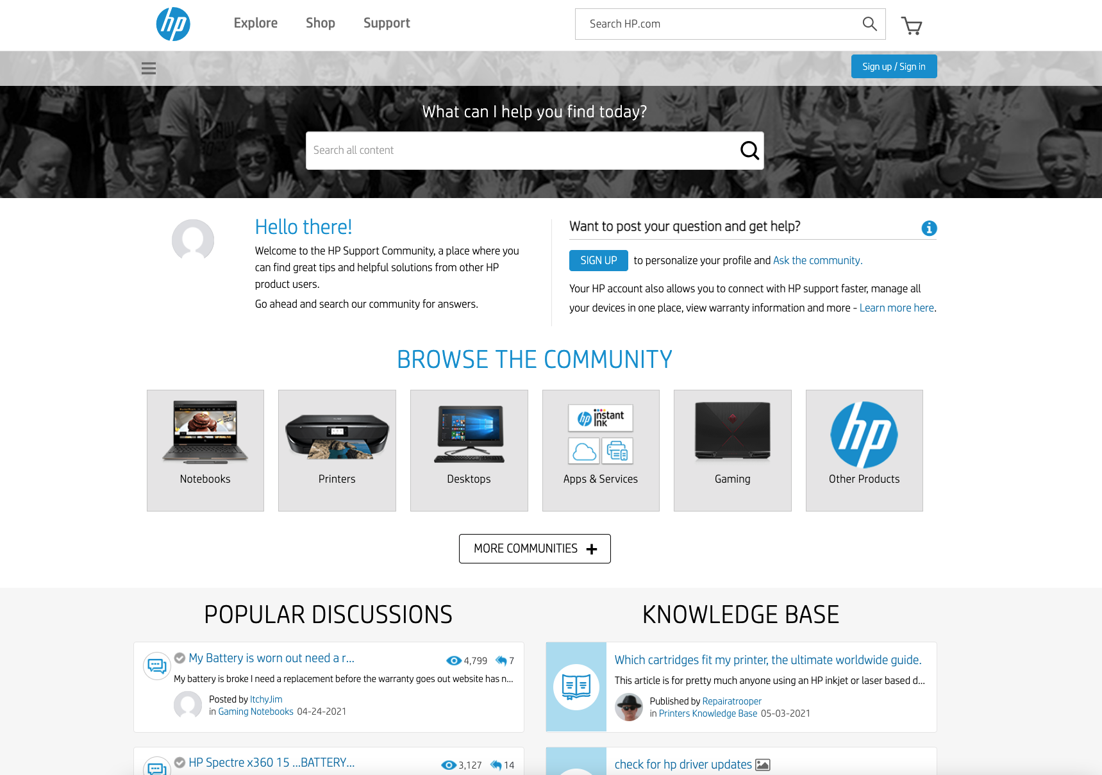
categorisation types
CREATING A SUCCESSFUL TAXONOMY
BY PRODUCT CATEGORIES
The HP community shown opposite primarily uses a product taxonomy. This is typically the best method of setting up a customer support community and reflects how members think.
However, companies which sell a far broader range of products, finding the best way of categorising them would be extremely difficult.

Slide 6
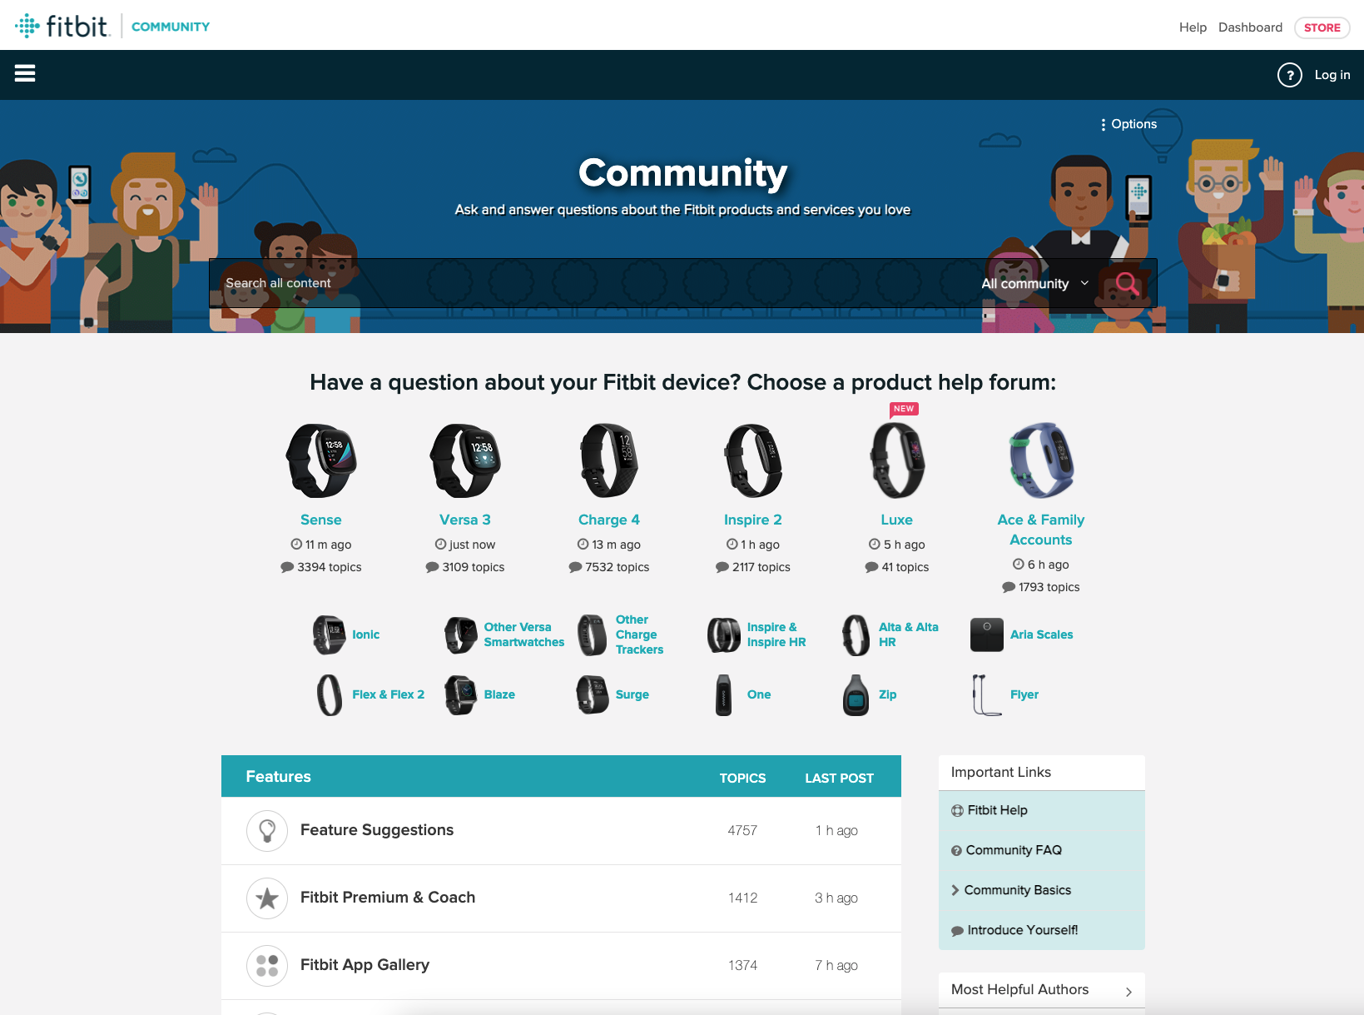
categorisation types
CREATING A SUCCESSFUL TAXONOMY
BY PRODUCT CATEGORIES
The FitBit community is another example of categorising the content in the community by product with emphasis given to the most popular products and then small icons / option given to less-popular product categories.

Slide 7
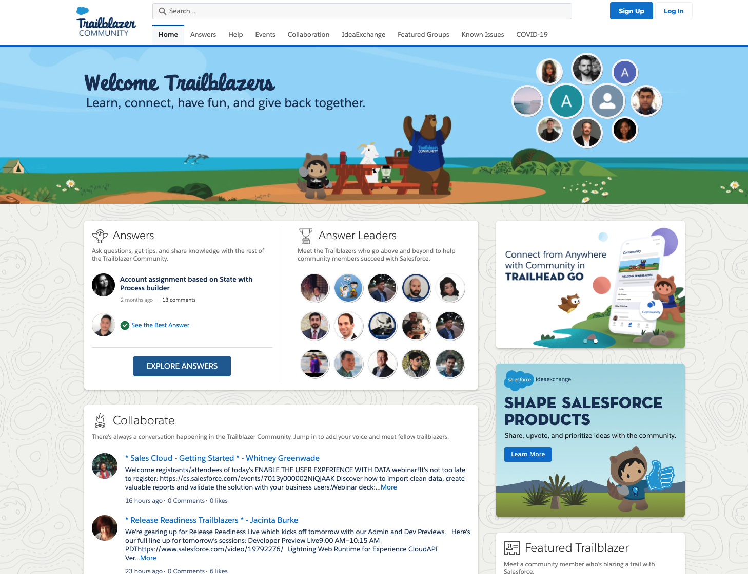
categorisation types
CREATING A SUCCESSFUL TAXONOMY
BY VISITING INTENT
The Salesforce Trailblazer community is categorised by the intent of the visitor. (answers, help, collaboration etc…). This is a popular approach but one with a very mixed success rate. Often one type of intent is 10x as popular as any other and it makes navigation of the entire site more difficult.
This works best if the community is deeply integrated into the broader product experience and members come to learn rather than just get answers.

Slide 8
simple taxonomy templates

Slide 9
taxonomy template
CREATING A SUCCESSFUL TAXONOMY
HOME | SEARCH | PRODUCT 1 | PRODUCT 2 | PRODUCT 3 | PRODUCT 4 (etc..) | SUPPORT | MY PROFILE / REGISTER
 |  | Sub-topic 1 | Sub-topic 1 | Sub-topic 1 | Sub-topic 1 | Contact support | Login/register
 |  | Sub-topic 2 | Sub-topic 2 | Sub-topic 2 | Sub-topic 2 | Getting started | Forgotten password
 |  | Sub-topic 3 etc..) | Sub-topic 3 etc..) | Sub-topic 3 etc..) | Sub-topic 3 etc..) | Documentation | Community 101
 |  | FAQ / Known issues | FAQ / Known issues | FAQ / Known issues | FAQ / Known issues | Rules and guidelines | Security, privacy, and legal
 |  | Product documentation | Product documentation | Product documentation | Product documentation | Acronyms and phrases
 |  | Trending labels | Trending labels | Trending labels | Trending labels | How gamification works
 |  | FAQ / Known issues | FAQ / Known issues | FAQ / Known issues | FAQ / Known issues | Superusers
 |  | Unanswered questions | Unanswered questions | Unanswered questions | Unanswered questions
 |  | Product experts | Product experts | Product experts | Product experts

Slide 10
taxonomy template
CREATING A SUCCESSFUL TAXONOMY
HOME | SEARCH | GET HELP | LEARN | SHARE ADVICE | GET STARTED | MY PROFILE / REGISTER
 | Trending topics | Product category 1 | Documentation | Create blog post | Join a mentoring group | Login/register
 | FAQ | Product category 2 | Community ‘tips’ blog | Answer questions | Top tips | Forgotten password
 |  | Product category 3 | Popular content | Become a mentor | Rules and guidelines | Community 101
 |  | etc… | Popular discussions | Unanswered questions | Common problems | Security, privacy, and legal
 |  | FAQ | Members to follow | Current member rankings | Help for first-timers
 |  | File a ticket | Known issues | How gamification works | Insider jokes
 |  |  | Meet the staff |  | Acronyms and phrases

Slide 11
taxonomy template
CREATING A SUCCESSFUL TAXONOMY
HOME | SEARCH | USERS | DEVELOPERS | RESELLERS | PARTNERS | SUPPORT | MY PROFILE / REGISTER
 |  | Ask Questions | Ask Questions | Ask Questions | Ask Questions | Contact Support | Login/register
 |  | User groups | Events | Conference | Events | Getting started | Forgotten password
 |  | FAQ / Known issues | Known issues | Resources | Local groups | Rules and guidelines | Community 101
 |  | FAQ | Report bug | Build your profile | Resources | Acronyms and phrases | Security, privacy, and legal
 |  | Trending issues | Documentation | Build your reputation | Ideas and feedback | How gamification works
 |  | Unanswered questions | Known issues | Known issues
 |  | Product roadmap | Product roadmap | Reseller blog
 |  | Top members | Top developers | Product roadmap

